Slide 1

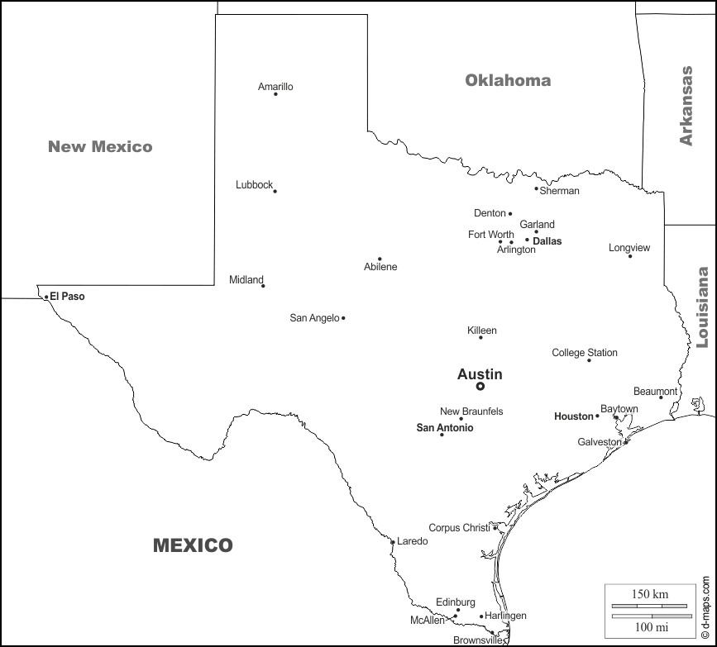
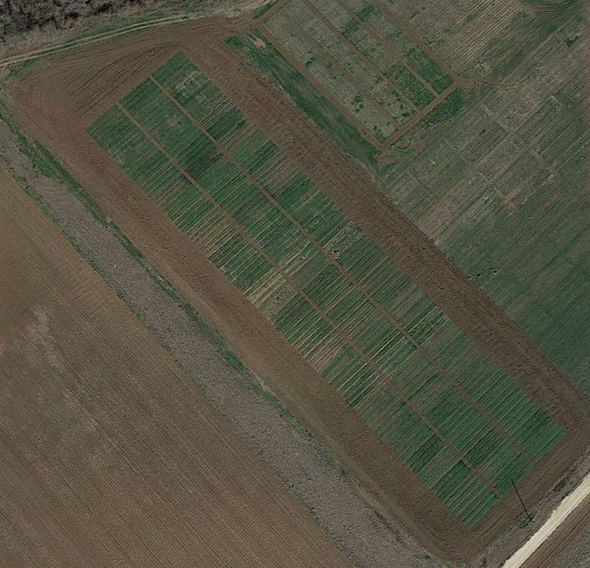
Effects of Different Cover Crops and Tillage on Greenhouse Gas Emissions in Soil Incubation
Sk. Musfiq-Us- Salehin¹, Nithya Rajan¹, Kenneth Casey², Jake Mowrer¹, Muthukumar Bagavathiannan¹
¹ Soil and Crop Sciences, Texas A&M University, College Station TX; ² Texas A&M AgriLife Research, Amarillo TX
Introduction
Methods
Decomposition of cover crops (CC) after termination stimulates microbial activity and can increase the greenhouse gas (GHG) emissions.
Tillage following CC termination accelerate the decomposition process and may promote the GHG emissions (Abdalla et al., 2014).
Different cover crops like legume, brassica, cereal and mix species of CC with residues incorporated or surface applied to the soil may have differential effects on GHG emission.
However, the carbon dioxide (CO₂), nitrous oxide (N₂O) and methane (CH₄) emissions after cover crop termination and incorporation into the soil is not adequately studied.
Soil incubation simulating the field condition of CC residues and tillage may help understand the GHG emissions dynamics in the system.
Study Site: near College Station, Texas (33.55ºN, 96.43ºW).
Climate: Humid subtropical.
Exp. Design: Split plot design with two tillage treatments as main plots and six cover crop treatments as subplots in three replications.
Treatments
Tillage | Cover crops | Seeding rate (kg ha⁻¹)
Conventional (incorporated) | Winter pea (Pisum sativum) | 56
 | Mustard (Brassica rapa) | 5.5
 | Oats (Avena sativa L.) | 78
Strip (surface applied) | Winter mix (mix of all three) | 46
 | Weed free (no cover crop) | --
 | Weedy (no CC and no weed control) | --
CC residues were applied just before soil incubation at the rates as in field.
Poultry litter was applied at a rate of 2.98 Mg ha⁻¹ (0.77 g per soil core).
Soils were stirred for conventional tilled plots and surface applied for strip till plots.
Research Hypotheses
Mix species of CC may have higher CO₂ emissions and legume CC would have higher N₂O emissions compared to other CC and no CC treatments.
Soil incorporation of residues may lead to higher GHG emission compared to surface applied.
Objectives
To investigate the effects of different CC on CO₂, N₂O and CH₄ emissions during incubation of undisturbed soil core samples at 29°C.
To study different residue management effects (surface applied or soil incorporated) on GHG emissions during the incubation.

Slide 2
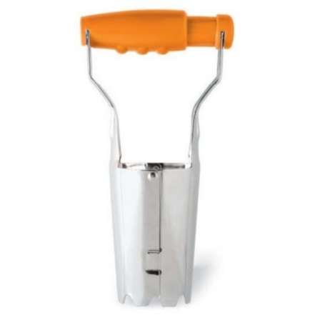
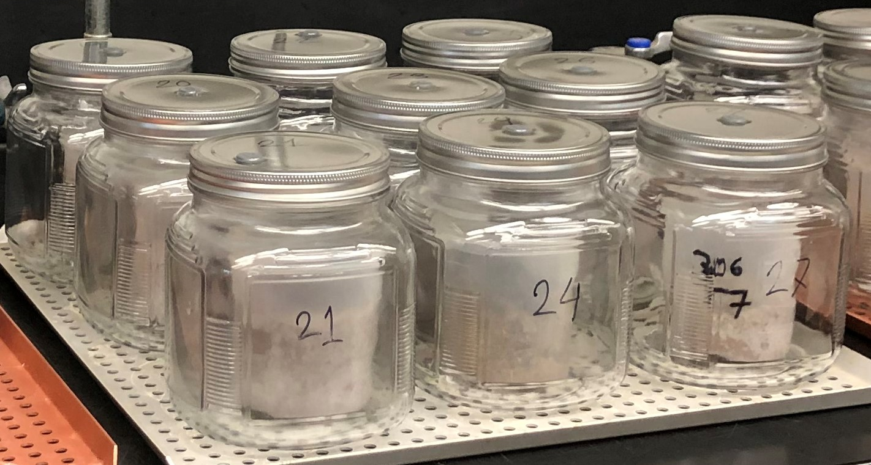
Soil Sampling and Incubation
Greenhouse Gas Emissions
Undisturbed soil core samples were collected from each plot after CC termination.
Core size: 5.72 cm inner diameter, 10.2 cm height (Fig-1).
Soil samples were placed in 250 ml cups and were stored in refrigerator at <4° C until incubation.
Incubation jars: Inner volume of 946 ml with airtight lids (Fig-2).
Soil water adjustment: 60% WHC.
Incubation temperature: 29°C.
Sampling days: 0, 1, 2, 4, 6, 10, 14, 22, 30, 45 days of incubation.
Sampling time: 0 and 4 hours after closing the lids.
Gas samples were stored in 12 ml evacuated vials.
Samples were analyzed for CO₂, N₂O and CH₄ concentration using a gas chromatograph.
Fig 1: Bulb planter used for undisturbed soil sampling.
Fig 2: Soils inside the airtight jar for incubation.
Results and Discussion
Winter mix had higher cumulative CO₂ emissions in both mixed and surfaced residues indicating higher microbial activity and soil respiration with balanced C:N ratio from cereal and legume CC (Fig-3). In mixed residues winter pea had higher CO₂ emissions compared to single species and no CC treatments which infers to that legume CC stimulated the microbial activity with proper soil aeration (Fig-3). In surface applied residues single species CC had observably higher CO₂ emissions compared to weedy and weed free treatments which indicates that the CC to some extent increased CO₂ emissions compared to no CC.
Days After Incubation
Fig 3: Cumulative CO₂ emissions (g kg⁻¹ soil) in response to different CC treatments of incorporated (A) and surfaced (B) residues.

Slide 3

Winter mix had higher cumulative N₂O emissions while residues were incorporated compared to other CC treatments, but no difference was observed in surface applied residues of CC (Fig-4). This result indicates the mix species while incorporated into the soil stimulated nitrifiers and denitrifiers’ activity compared to other CC and control. Surprisingly, single species legume CC didn’t have any effect on N₂O emissions which is opposite of our hypothesis.
Oats had higher cumulative CH₄ emissions while residues incorporated but no observable difference in surface applied (Fig-5). This indicates the availability of mineralizable C from higher biomass of oats may have led the higher CH₄ emissions (Haque et al., 2013). Overall CH₄ emissions were negligible and residue incorporation didn’t differ from surfaced treatment in terms of CH₄ emission.
Days After Incubation
Fig 4: Cumulative N₂O emissions in response to different CC treatments of incorporated (A) and surfaced (B) residues.
Days After Incubation
Fig 5: Cumulative CH₄ emissions in response to different CC treatments of incorporated (A) and surfaced (B) residues.
Conclusions
References
Balanced C and N availability from mix species CC stimulated the microbial activity and increased CO₂ emissions in both residue management. Legume CC had higher CO₂ emissions while residues were mixed into the soil.
Mix species CC treatment when residues were incorporated had higher N₂O emissions. Low C:N ratio legume CC treatment didn’t increase N₂O emissions compared to no CC treatments.
Oats residues increased CH₄ emissions when incorporated with soil but overall CH₄ emissions were very negligible and no difference among CC treatments were found in surface applied treatments.
Abdalla, M., Hastings, A., Helmy, M., Prescher, A., Osborne, B., Lanigan, G., ... & Jones, M. B. (2014). Assessing the combined use of reduced tillage and cover crops for mitigating greenhouse gas emissions from arable ecosystem. Geoderma, 223, 9-20.
Haque, M. M., Kim, S. Y., Pramanik, P., Kim, G. Y., & Kim, P. J. (2013). Optimum application level of winter cover crop biomass as green manure under considering methane emission and rice productivity in paddy soil. Biology and fertility of soils, 49(4), 487-493
Acknowledgment
Undergraduate student workers Giordano (Bruno) Fontana and Walker Crane
Grant # 2019-51106-30192

