Slide 1

Introduction
Brassica carinata (carinata), a non-food oilseed feedstock, has demonstrated good yield potential as a winter biofuel crop in the south eastern (SE) United States (US)
In order to fit carinata in the existing cotton-peanut cropping system in the SE US, early maturity genotypes are needed. However, nutrient uptake and accumulation data for early maturity genotypes are not well documented in carinata literature
There are limited data regarding temporal nutrient accumulation and partitioning dynamics of carinata. As a recently introduced crop in the SE US, such studies inform the rate of macro and micronutrient accumulation and aid fertility management decisions
The objectives of this study were 1) to quantify nutrient uptake and partitioning across maturity classes 2) to determine if nutrient uptake and partitioning will differ among latitudes for full season genotype

Slide 2
Methods
Plant tissue samples were sampled at multiple growth stages and partitioned into leaves, stems (petiole plus stem), reproductive parts (flowers and pods), and seed to determine biomass and nutrient accumulation
Partitioned biomass was dried and ground to pass a 2-mm screen, chemically digested in a digestion block with nitric acid, and subjected to elemental analysis using inductively coupled plasma optical emission spectrometry (ICP-OES)
Total carbon and total nitrogen were analyzed by dry combustion (AOAC, 2006)
Total nutrient uptake was determined by multiplying aboveground dry matter by nutrient concentration
ANOVA using PROC GLIMMIX procedure in SAS version 9.4
Multiple comparison procedures were done using Fisher’s protected least significant difference (LSD) at 95% confidence level

Slide 3

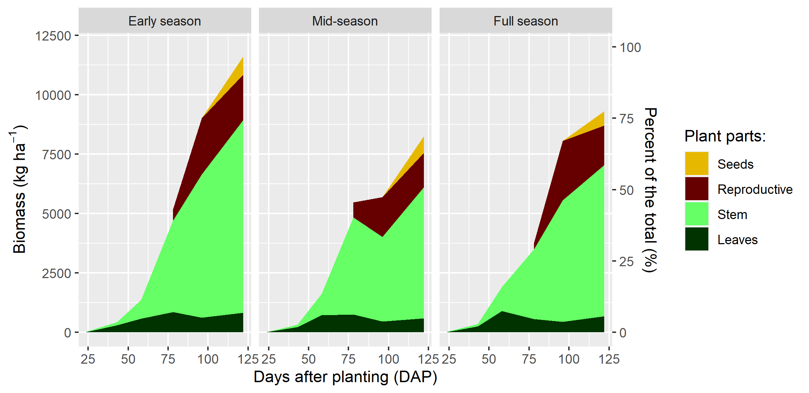

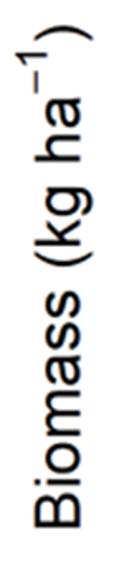
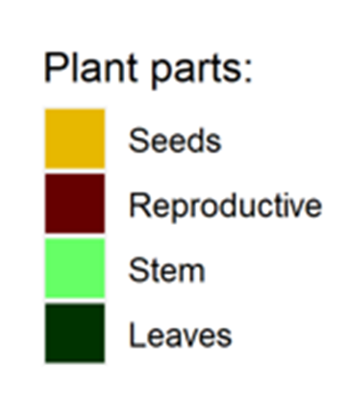
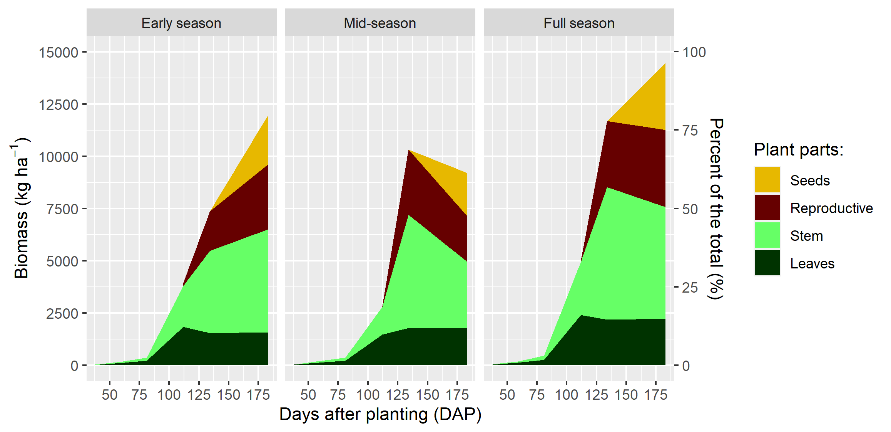

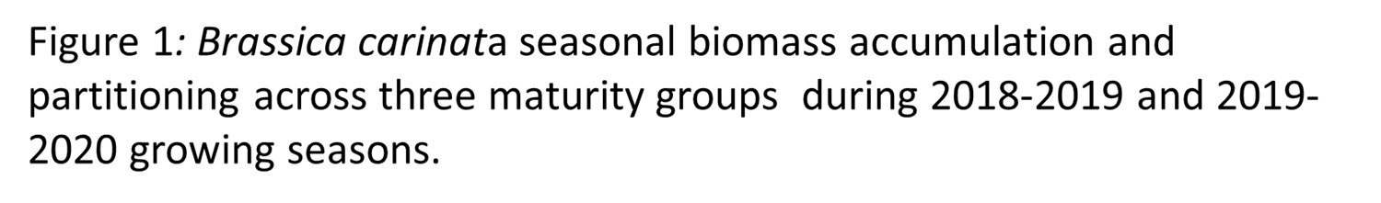
Results
Table 1: Brassica carinata end of season dry matter partitioning for full season genotype across Jay, FL and Salisbury, NC for 2018-2019 and 2019-2020 growing seasons
EFFECT |  | Jay | Salisbury
 |  | ------ kg ha⁻¹------
2018-2019 | leaf | 678a† | 3b
 | stem | 6366a | 1161b
 | reproductive | 1656a | 1320a
 | seed | 1250a | 611b
2019-2020 | leaf | 2221a | 66b
 | stem | 5355a | 5576a
 | reproductive | 3693a | 2735a
 | seed | 3188a | 2355a
Different letters within a row represent significantly different means, (LSD, p ≤ 0.05)

