Slide 1
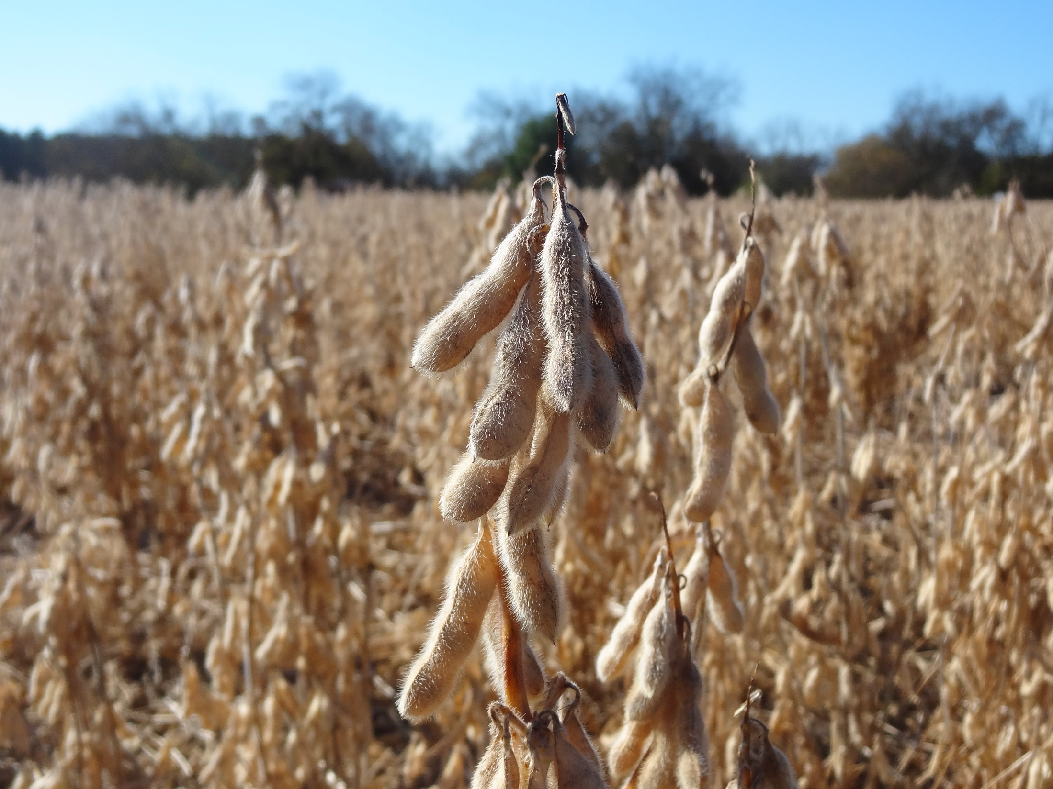



Soybean Maturity Group IV and V Response to Seeding Rate in Virginia
Lindsey Bowers - M.s. Candidate
Dr. David L. Holshouser
2021 ASA Southern Regional Branch

Slide 2
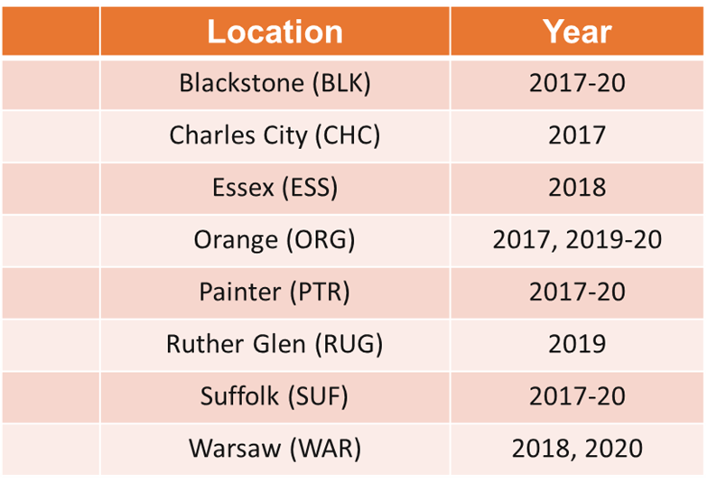

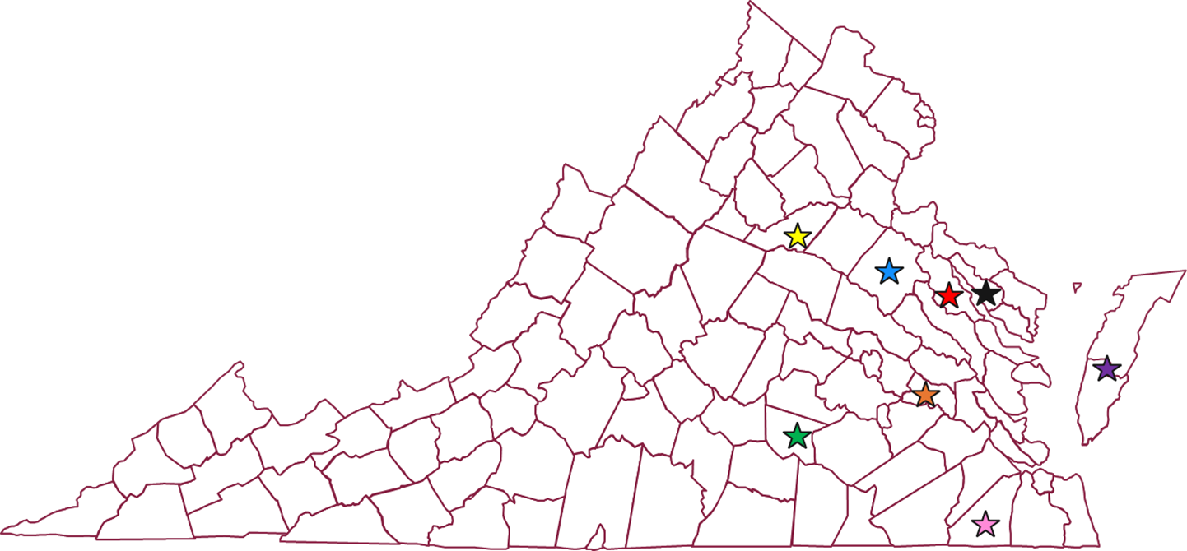
Materials & Methods
Figure 1. Location and site-year of experiments in the state of Virginia between 2017-20
Research conducted at 20 site-years from 2017-20 across Virginia (Figure 1).
Seeding Rate (1000/ha):
  Full-season: 74, 148, 222, 297, 371, and 445.
  Double-crop: 198, 297, 395, 494, 544, and 593.
Randomized complete block (RCB) with 4 replications.
Asgrow Varieties with MG:
  MG IV: AG47X6, AG48X7, and AG48X9.
  MG V: AG 52X9, AG54X6, AG56X8, and AG58X9.
Data subjected to analysis of variance and interaction between site, seeding rate, and maturity group determined.
Soybean yield regressed on plant population density (PPD) using linear regression techniques across sites.
Relative yield regressed on Area Under Normal Difference Vegetative Index (NDVI) Curve (AUNDVIC) with linear regression techniques.

Slide 3




Results
Full-Season MAX
Double-Crop MAX
Leaf Area Index
Yield was maximized at 150-200k/ha.
Yield was maximized at 300-400k/ha.
NDVI related to yield across all sites.

