Slide 1



Effect of Hemp Residue Management on Biological Soil Health Indicators
INTRODUCTION
Hemp (Cannabis sativa L.) is an ideal carbon sink as it can capture more CO₂ per ha than other commercial crops.
Biochar addition to soil has many benefits including stimulation of specific soil microorganisms, soil enzymatic activity, soil respiration which could lead to enhanced biological activity and nutrient cycling or retention
Limited studies have reported the effect of hemp derived biochar on biological soil health indicators
OBJECTIVE
Investigate the effects of hemp biochar, hardwood biochar (pyrolysis temperature of 800 ̊C) and hemp residue (representing a range of C:N ratio) on soil microbial population and enzyme activity.

Slide 2
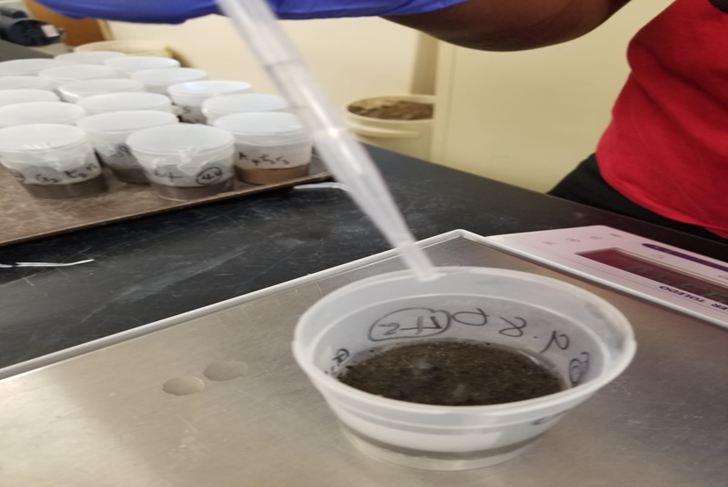
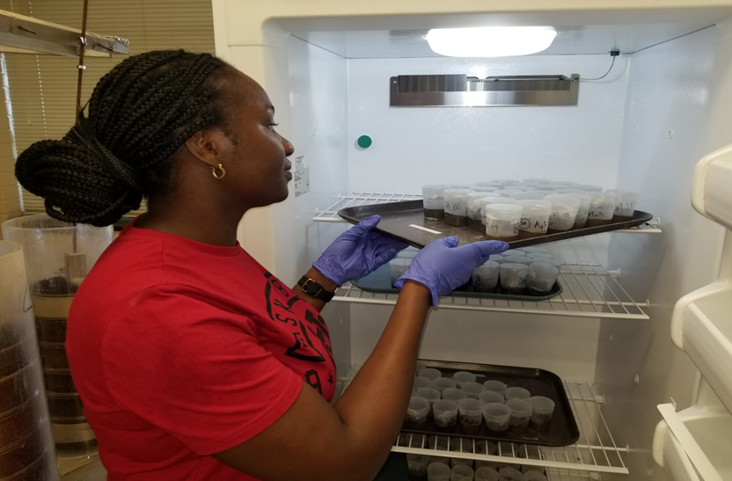
Effect of Hemp Residue Management on Biological Soil Health Indicators
METHODOLOGY
Soil sampling: Composite soil samples (0-15 cm) were collected from 2 experimental sites representing different climatic conditions, soil characteristics, and soil management histories
Center for Environmental Farming Systems (CEFS) in Goldsboro(Coastal) and
NC A&T research farm in Greensboro(Piedmont).
A 72 -d lab incubation experiment was designed
Amendments:
Hemp residue (HR; C:N= 38.8)
Hemp biochar (HB; C:N=65.4)
Hardwood biochar (HA; C:N=172.5)
@ 0.5% (dry wt. added to dry soil)
Soil microcosms were maintained at 60% WFPS for 72 days or followed by a 7d dry-wet cycle
Fig 1 and 2: Hemp residues added to soil incubation experiment and maintained at fixed moisture content.

Slide 3
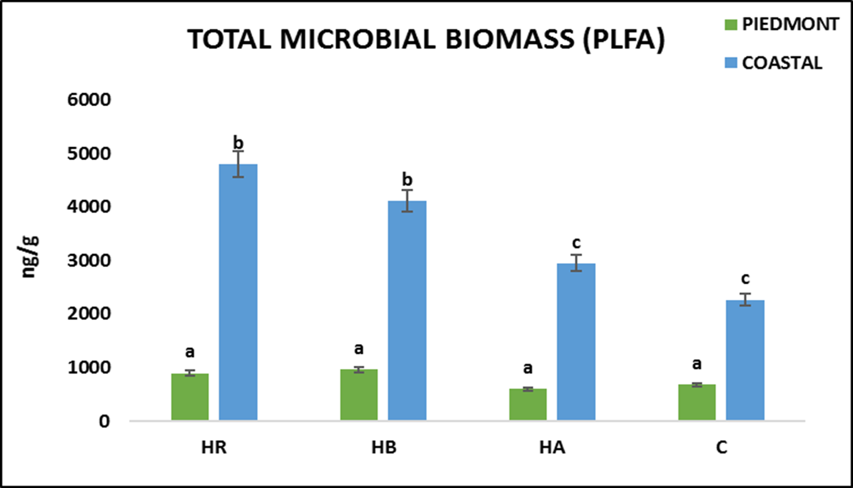
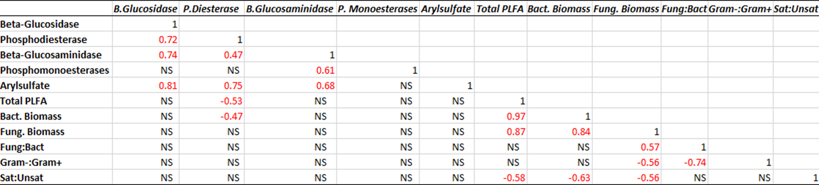
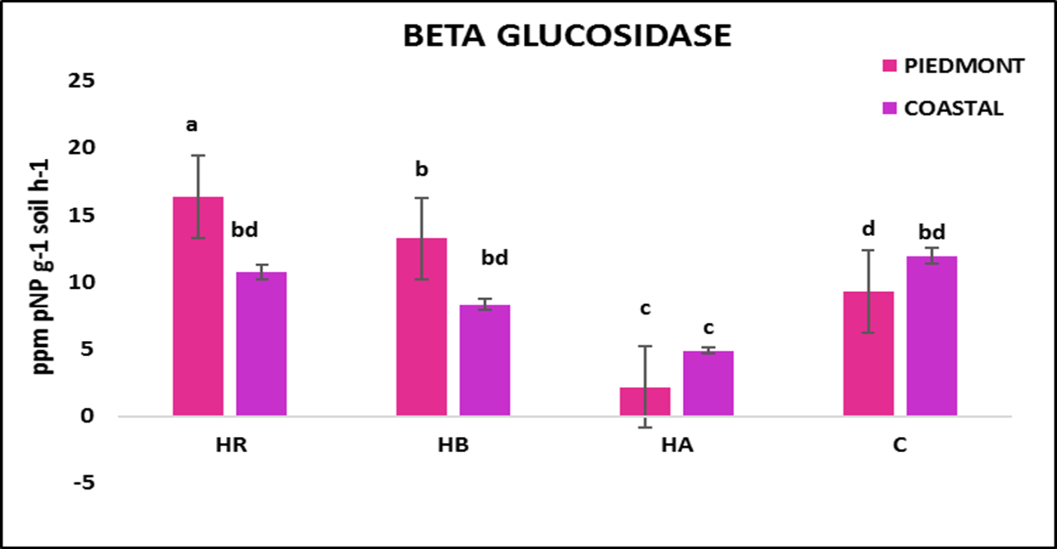
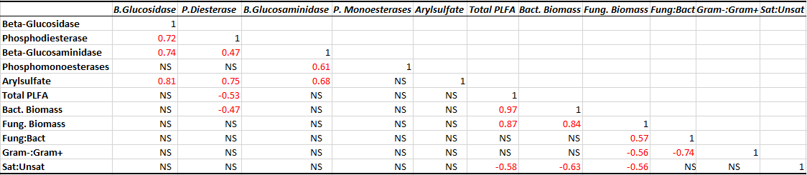
Effect of Hemp Residue Management on Biological Soil Health Indicators
RESULTS
Table 1. Correlation matrix showing the interactions between the soil microbes and enzyme activity at d30
Fig 3. The total PLFA in Coastal soils were higher as compared to Piedmont which showed no significant difference between all treatments .
Total PLFA positively correlated with bacteria biomass and fungi biomass
Enzyme B. glucosidase positively correlated with phosphodiesterase, beta-glucosaminidase and arylsulfate
Fig 4. Soil Beta Glucosidase activity showed higher trends in all Piedmont soil as compared to coastal soil across the treatments
M.S. student at North Carolina A&T State University
Email:isadesina@aggies.ncat.edu
P.I: Dr. Arnab Bhowmik Email:abhowmik@ncat.edu

