Slide 1
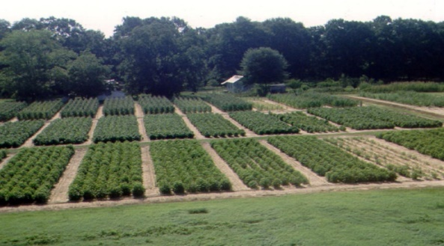



Soil Health and Crop Yield Influenced by 100+ Years of Soil Fertility Management
Soil Health and Crop Yield Influenced by 100+ Years of Soil Fertility Management
Hannah L. Decker¹, Rishi Bhandari², Audrey V. Gamble¹, & Yucheng Feng¹
1Auburn University, Department of Crop, Soil, and Environmental Science
2 Auburn University, Department of Entomology and Plant Pathology
INTRODUCTION
> 100 years of fertility management
Cotton-soybean-corn-wheat rotation
Conservation tillage for > 20 years
Marvyn loamy sand: siliceous, thermic Typic Kanhapludult
Treatments replicated three times in block design
Soil samples were collected according to treatment in spring, summer, and fall from the 0-10 cm soil depth.
TREATMENT | Winter Legume | Commercial Fertilizer According to Soil Test Recommendations
 |  | N | P | K | S | Lime
COMPLETE | ✓ | ✓ | ✓ | ✓ | ✓ | ✓
N no LEGUME |  | ✓ | ✓ | ✓ | ✓ | ✓
LEGUME no N | ✓ |  | ✓ | ✓ | ✓ | ✓
NO N |  |  | ✓ | ✓ | ✓ | ✓
NO P | ✓ | ✓ |  | ✓ | ✓ | ✓
NO K | ✓ | ✓ | ✓ |  | ✓ | ✓
NO LIME | ✓ | ✓ | ✓ | ✓ | ✓
CONTROL
SOIL HEALTH
INDICATORS
MEASURED
CHEMICAL
pH²
Mehlich-I³
Permanganate oxidizable carbon¹
Organic carbon
BIOLOGICAL
Microbial
biomass C⁵
ACE Protein⁶
PHYSICAL
Aggregate Stability⁴
The Cullars Rotation (est. 1911)
in Auburn, AL
OBJECTIVE
Data were analyzed using SAS v 9.4 using PROC GLIMMIX procedure.
Mean separations were performed using Tukey’s honestly significant difference (HSD) test α = 0.05.
References:
¹Weil et al. 2003. ²McLean, E. O. 1982. ³Hue & Evans. 1979.
⁴Kemper & Rosenau. 1986. ⁵Horwath & Paul. 1994. ⁶Modified from Moebius-Clune, D. J. 2016.
Evaluate the effect of long-term fertility management and cover crop use on selected soil health indicators.

Slide 2

RESULTS
Control
Control
Control
Control
Control
Difference in letters indicates a significant difference at α< 0.05

Slide 3
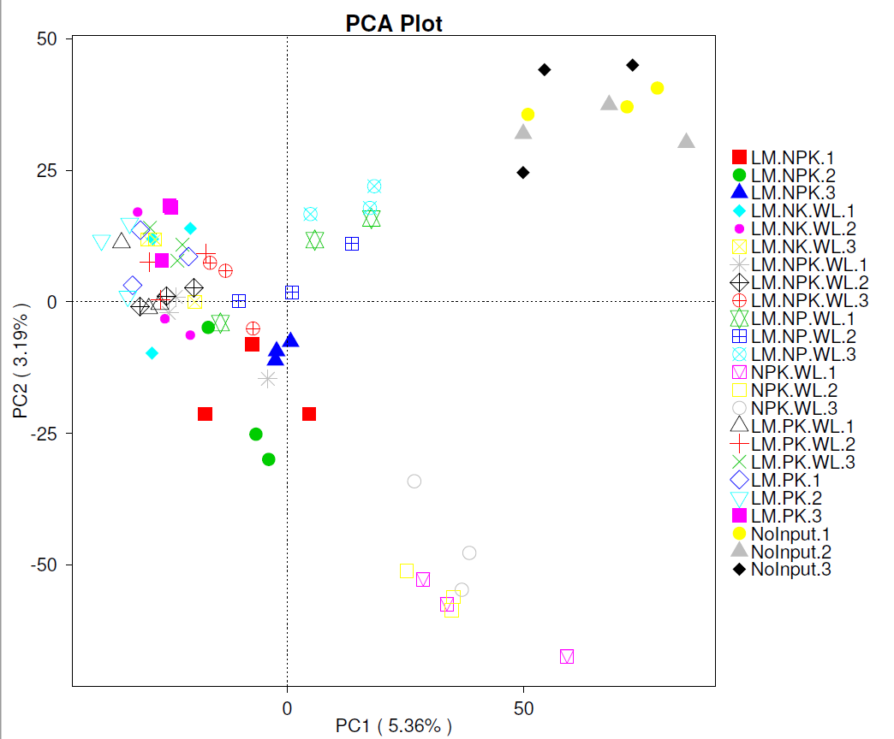
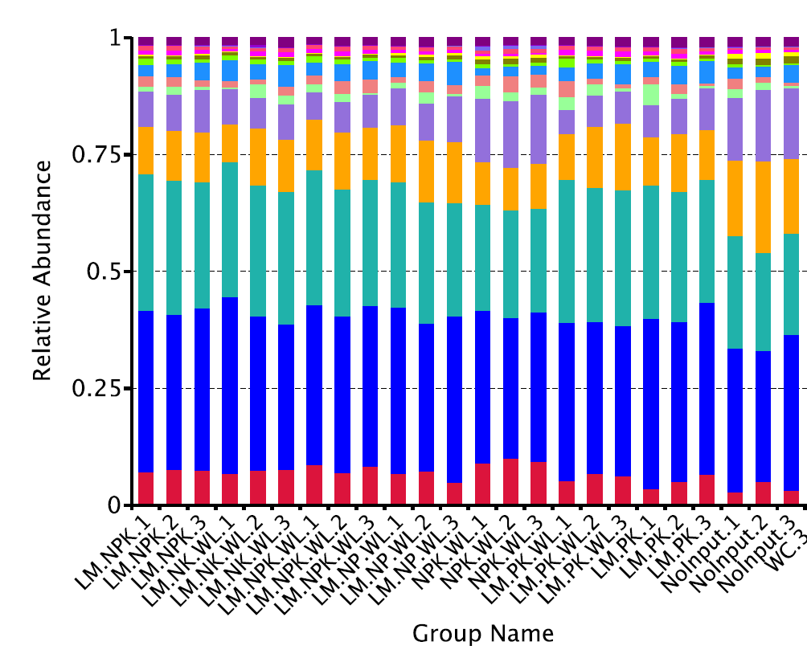
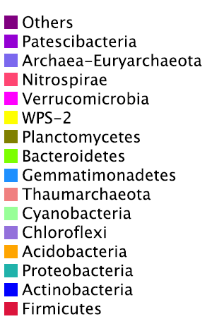
RESULTS
NnoLegume 1
NnoLegume 2
NnoLegume 3
NoP 1
NoP 2
NoP 3
Complete 1
Complete 2
Complete 3
NoK 1
NoK 2
NoK 3
NoLime 1
NoLime 2
NoLime 3
LegumenoN 1
LegumenoN 2
LegumenoN 3
NoN 1
NoN 2
NoN 3
Control 1
Control 2
Control 3
NnoLegume 1
NnoLegume 2
NnoLegume 3
NoP 1
NoP 2
NoP 3
Complete 1
Complete 2
Complete 3
NoK 1
NoK 2
NoK 3
NoLime 1
NoLime 2
NoLime 3
LegumenoN 1
LegumenoN 2
LegumenoN 3
NoN 1
NoN 2
NoN 3
Control 1
Control 2
Control 3
ACKNOWLEDGEMENTS
Funded by UDSA NIFA and Alabama Agricultural Experiment Station.

