Slide 1

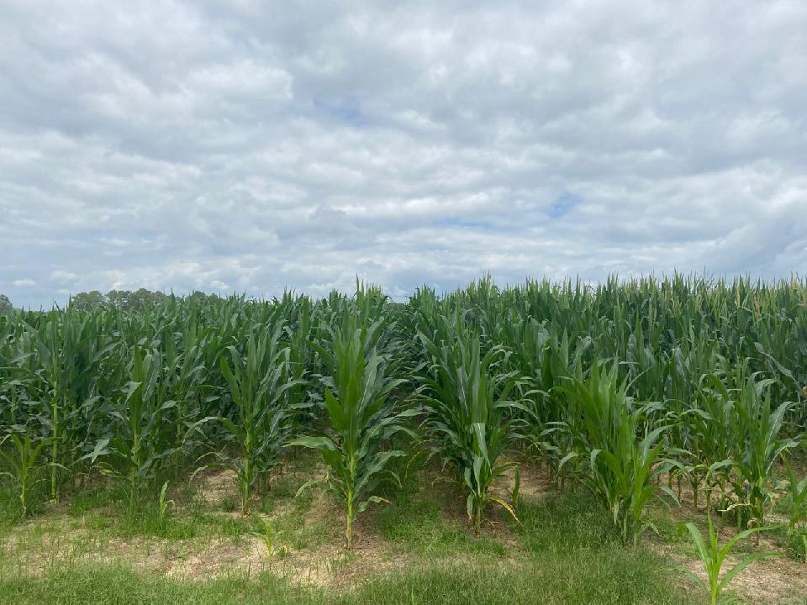
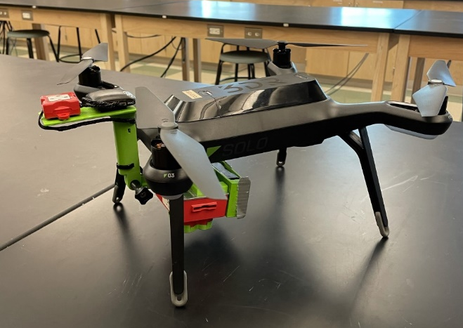
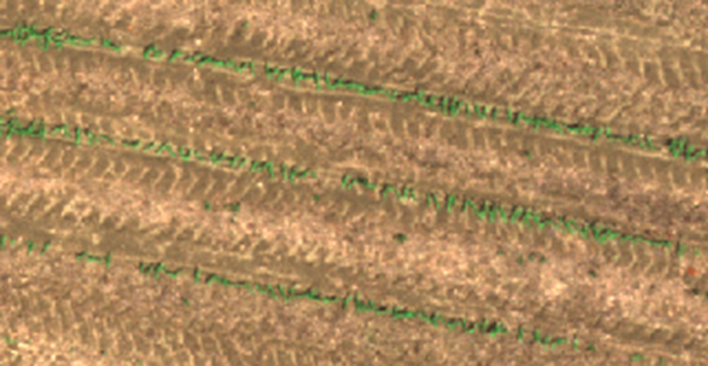

USING REMOTE SENSING TO PREDICT YIELD AND COUNT EMERGENCE IN CORN
Andrew R. Russell, Luther D. Altman, Emma G. Tyre,
Michael J. W. Maw, Alex J. McLemore
Manually counting corn is a time and labor-intensive process; however, determining the emergence is important for yield predictions and fertilizer calculations.
Our goal is to build a model using remote sensing imagery to establish
a stand count
This was a one-year study funded by GA Corn Commission conducted at Woodroof Farm at ABAC

Slide 2

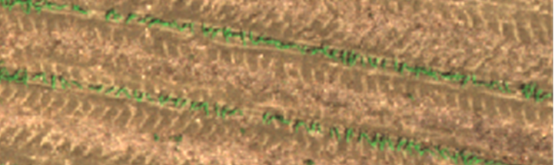
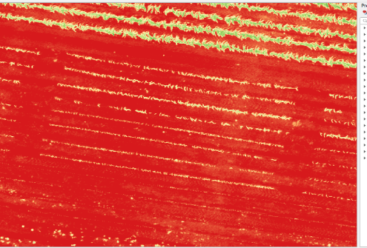
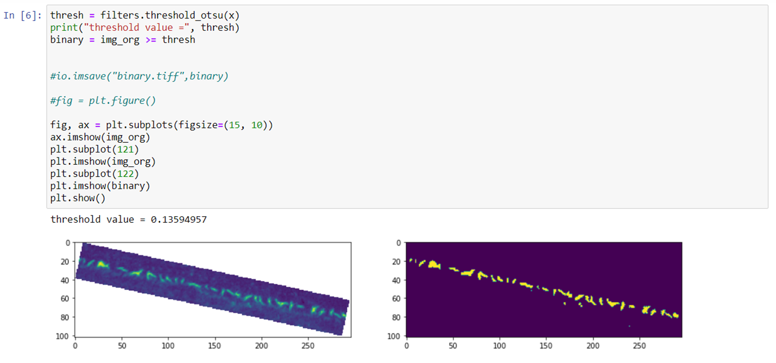

Materials & Methods
Starting at 10 DAP, images were captured every 7 days by UAS
Imagery was processed into NDVI images in QGIS
Sections of these rasters could be isolated
and exported into an external script
Using both manually set thresholds and automated using a script based off Otsu we were able to plot a relationship between pixels and plant counts
With an R-squared value consistently around 0.5 both yield and the emergence model offer strong overall trends that could be replicated in another study

Slide 3
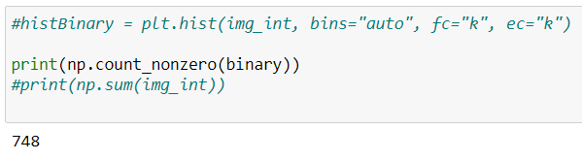
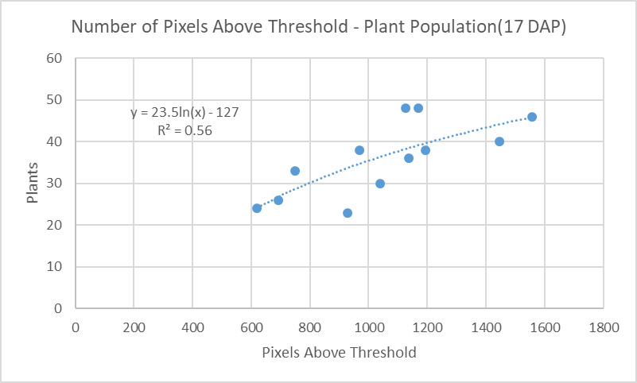
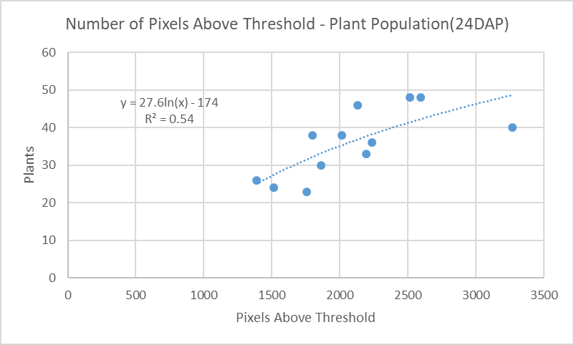
Results
Using NDVI as a means of determining plant population shows promise when pixels above an automatically set threshold are counted and compared to the number of plant physically counted within that area.
Conclusion
Future tests would benefit from more frequent flights and closer monitoring of physical plant populations and health within the same frame as the exported images.
Amount of pixels above the calculated NDVI Threshold

