Slide 1

Introduction
    Crop yield goals is a prevailing method for nitrogen recommendation
    Flat rate applications result in an over or under application leading to economic and environmental consequences
    The objective of this research was to identify the agronomic optimum nitrogen rates at different precision management levels
    Our hypothesis was that at each management level, location specific variations will require different N rates to reach maximum yield

Slide 2
Materials & Methods
Twelve nitrogen rate treatments were replicated 4 times over 4 locations, namely Starkville, Stoneville, Verona and Brooksville, MS
The agronomic optimum nitrogen rate was calculated by plotting yield with applied nitrogen rates using linear, quadratic, linear plateau and quadratic plateau models using the “Easynls package” in R statistical software
Analysis of variance was completed using GLIMMIX procedure in SAS statistical software and differences among treatment means were separated using Fisher’s LSD procedure

Slide 3
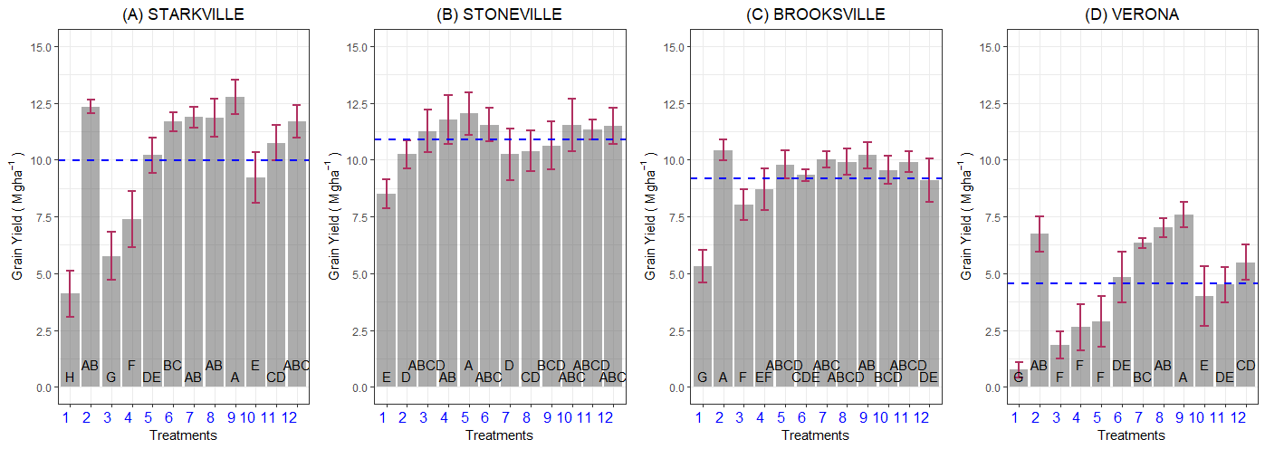
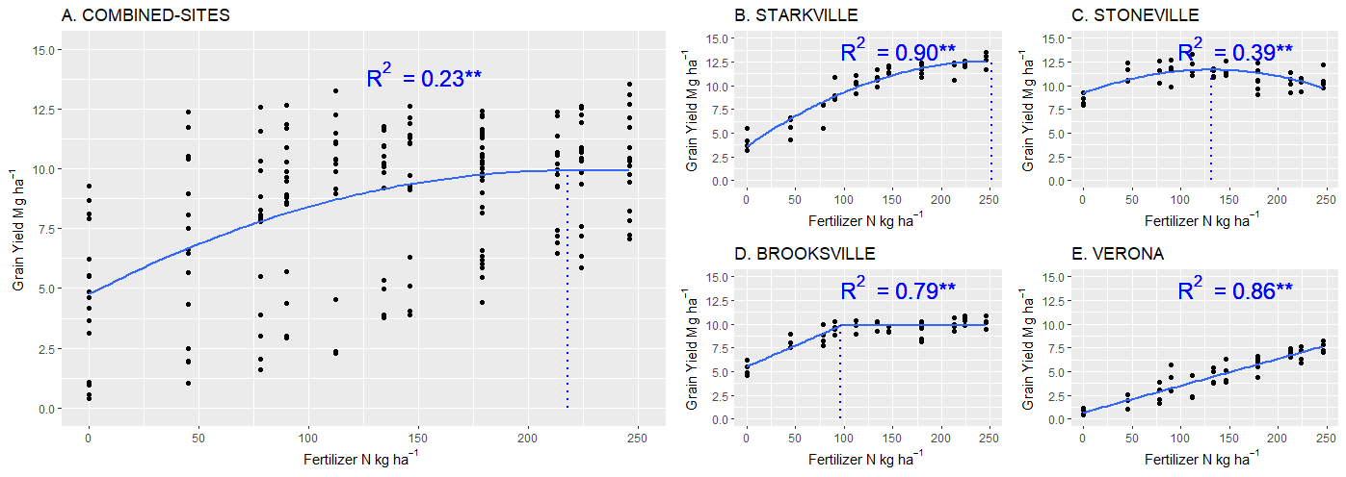
Results
This study necessitates the use of a combination of sensing platforms, plant morphological features, and climatological data in building location specific models to make nitrogen recommendations
Figure 1. The effect of total N application rate on grain yield in Starkville (A), Stoneville (B), Brooksville (C), and Verona (D), MS. The horizontal blue dotted line represents environmental mean at each location. Columns with the same letters were not significantly different, LSD P < 0.05.
Figure 2. The effect of total N application rate on grain yield. All data combined (A), Starkville (B), Stoneville (C), Brooksville (D), and Verona (E), MS. The coefficient of determination (R²) with * and ** indicating P < 0.05 and 0.01 respectively. The vertical blue dotted line represents agronomic optimum nitrogen rate (AONR) at which the maximum yield was obtained.

