Slide 1
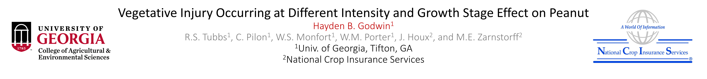

Introduction
Physical injury of crops can occur from different sources:
  Hail storm damage
  Animal feeding
  Movement of animals or equipment through the field
Understanding this injury aids management decisions after it occurs.
Evaluating recovery compared to non-injured plants will help growers and insurance adjusters decide how to manage crop after injury.
  Objective – Will physical injury to vegetation impact peanut production?

Slide 2
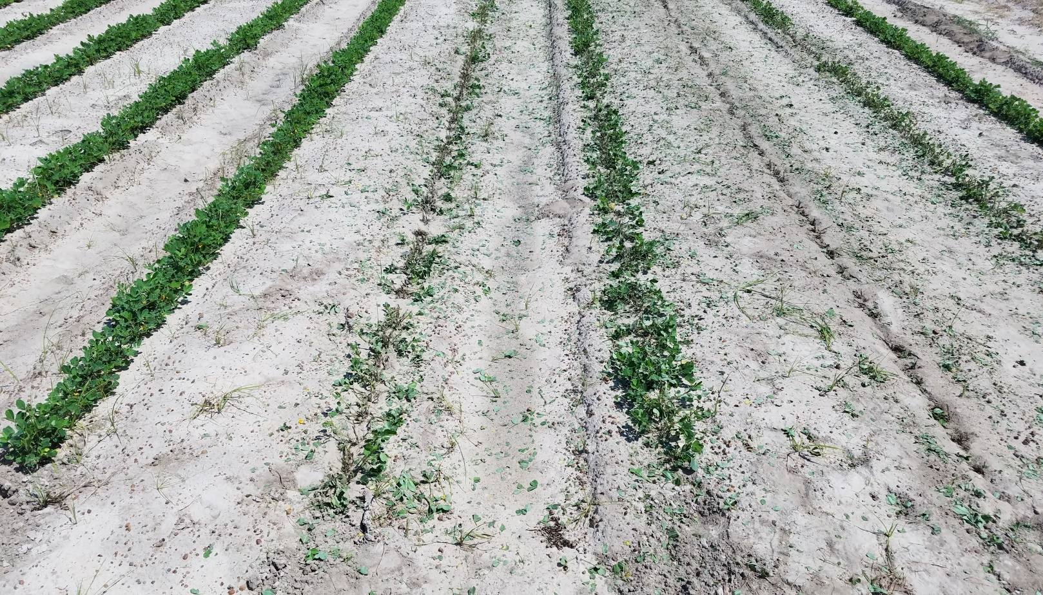
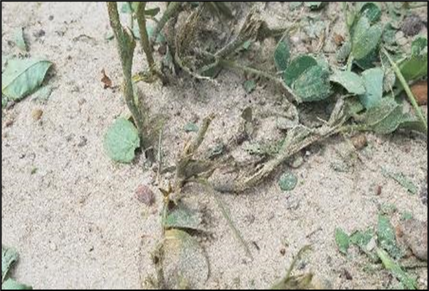
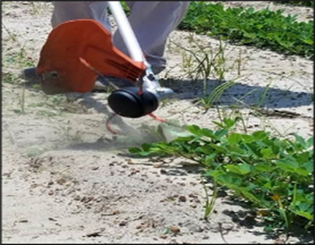
Materials and Methods
Injury treatments applied using gas powered weed trimmer (Figures 1 and 2).
Injury treatments applied at four times in the season at three intensities:
  30, 60, 90, and 120 Days After Planting (DAP)
  33, 66, and 99% injury levels (Figure 3)
Unharvested pods collected by sifting through the inversion zone to scavenge remaining pods left in the soil after digging.
NDVI measured using a Crop Circle Active Light Sensor (Holland Scientific).
None
66%
33%
99%
Figure 1. Injured peanut plant after treatment
Figure 2. Injury simulation
Figure 3. Calibration rows, injury levels at 30 DAP

Slide 3
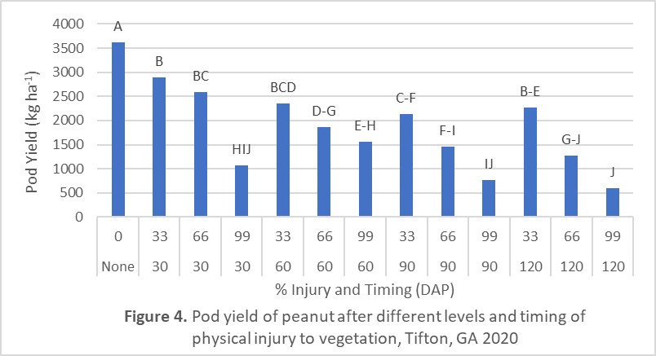
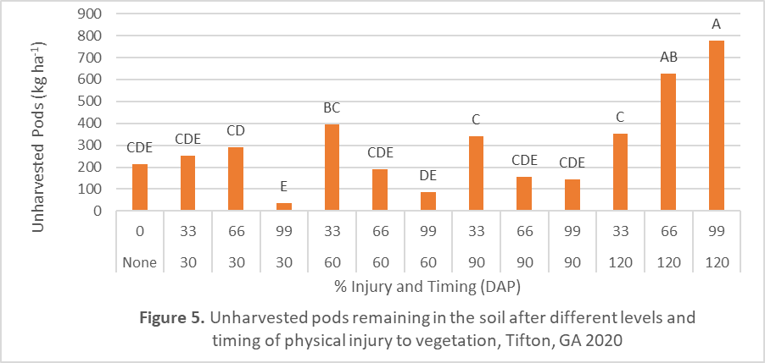
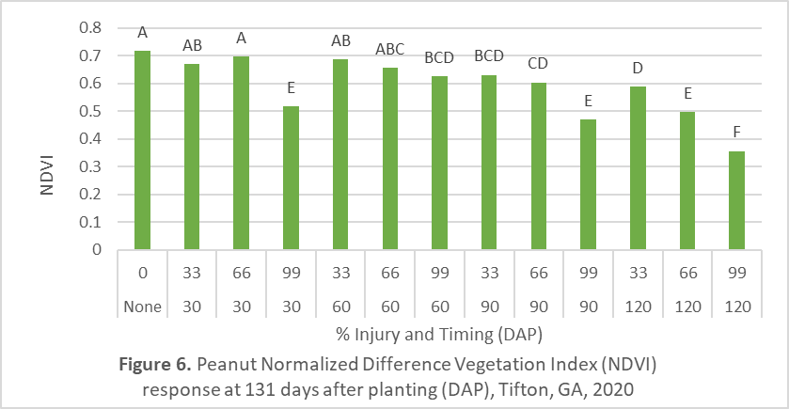
Results
Yield (Figure 4)
Yield reduced with increasing intensity for any given treatment date.
Continued management after 99% intensity not recommended regardless of timing.
Economic analysis needed to determine breakeven for other timings and intensity levels.
Unharvested Pods (Figure 5)
Unharvested pods greatest at 120 DAP with 66% and 99% injury.
Injury at 66 or 99% intensity may salvage yield potential with fewer losses if harvested immediately since no opportunity for recovery.
NDVI (Figure 6)
NDVI values recovered for 33% and 66% injury levels at 30 and 60 DAP.
Greatest opportunity for vegetative recovery at 60 DAP timing across all intensities.
Canopy recovery reduced when injury occurred at 90 or 120 DAP.
Conclusions
Physical injury to peanut canopy had a negative influence on yield.
Plants can recover from less severe damage early in season but unable to recover from severe damage late in season.

