Slide 1

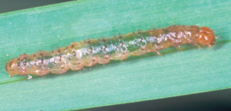
Media optimization for turf bermudagrass experimental line FB1628 callus development
Adina Y. Grossman*¹, Rebecca O. Arias¹, Kevin Begcy², Kevin E. Kenworthy¹, Esteban F. Rios¹
¹Agronomy Department, University of Florida, ²Environmental Horticulture Department, University of Florida *Corresponding Author: adinaygrossman@ufl.edu
Introduction
Bermudagrass (Cynodon spp.): widely grown warm-season forage and turfgrass crop.
Tropical Sod Webworm (TSW) (Herpetogramma phaeopteralis): destructive turfgrass pest in FL.
Agrobacterium-mediated transformation to insert cry1Ac for delta-endotoxin of Bt.
Low calli growth with hormone concentrations
from Hu et al. (2005).
Auxin and cytokinin concentration and ratio for
callus development differ by genotype (Beyl, 2010).
Tropical Sod Webworm Larval Stage (Tofangsazi et al., 2014)
Notes:
.

Slide 2
Objectives
Optimize callus induction media (CIM) for bermudagrass line FB1628 to regenerate calli
Materials and Methods
Media: MS (4.4 g/L), L-proline (2.0 g/L), Myo-Inositol (100 mg/L), CH (300 mg/L), Sucrose (30 g/L), Phytagel (3g/L), Plant Preservative Mixture (0.5 mL)
9 treatments: combinations of 2,4-D (auxin) and Benzyladenine (BA - cytokinin).
[2,4-D]: 0.5 ml/L, 1 ml/L, 1.5 ml/L
[BA]: 0.1 ml/L, 0.2 ml/L, 0.3 ml/L
Sterilized FB1628 nodes, placed on CIM, stored at 28 ⁰F in the dark.
Recorded % regenerated shoots, roots, and calli, 1 and 2 weeks after treatment initiation, using 3 reps.

Slide 3
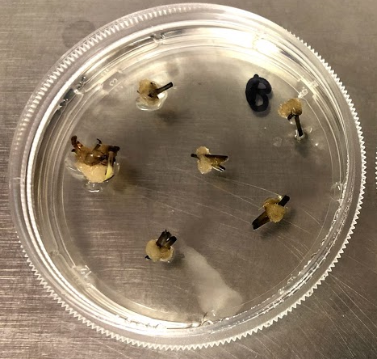
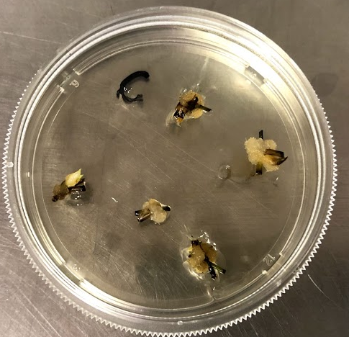
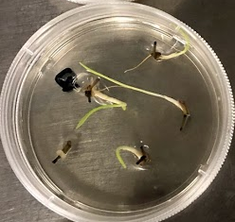
Results
Comparison of regenerated tissue for each treatment of 2,4-D and BA ratio, and concentration.
Conclusion: Higher concentrations of 2,4-D and BA are required for calli formation in FB1628.
A
B
C
Callus formation of FB1628 for 1 mg/L 2,4-D, 0.2 mg/L BA (A), 1.5 mg/L 2,4-D, 0.3 mg/L BA (B), and 1.0 mg/L 2,4-D, 0.1 mg/L BA (C).

