Slide 1
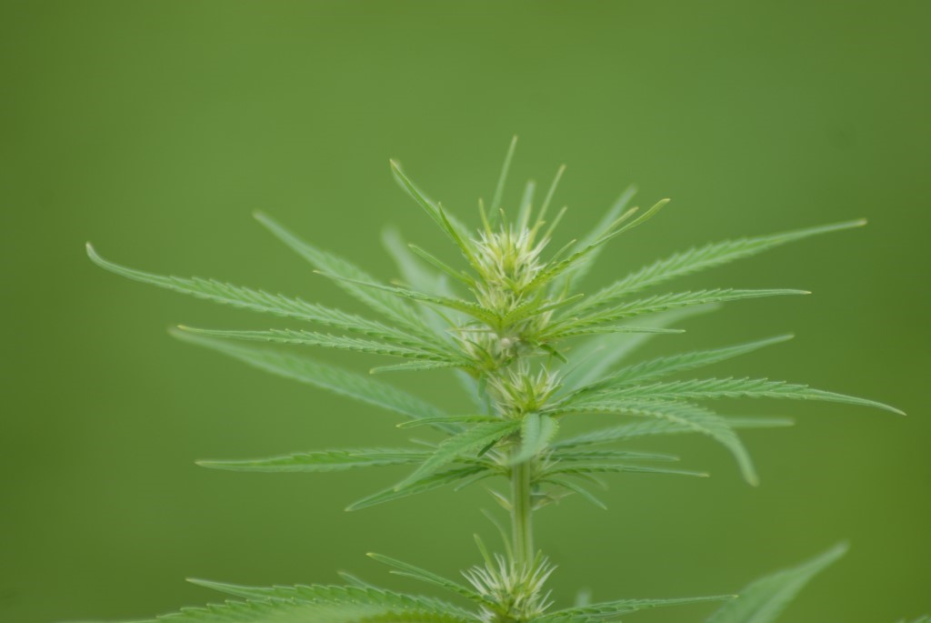


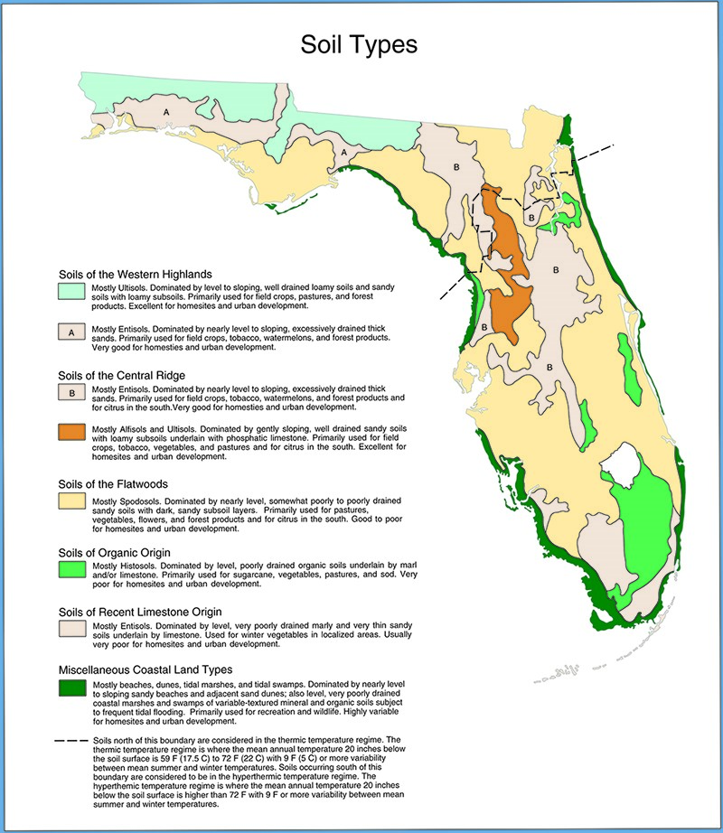
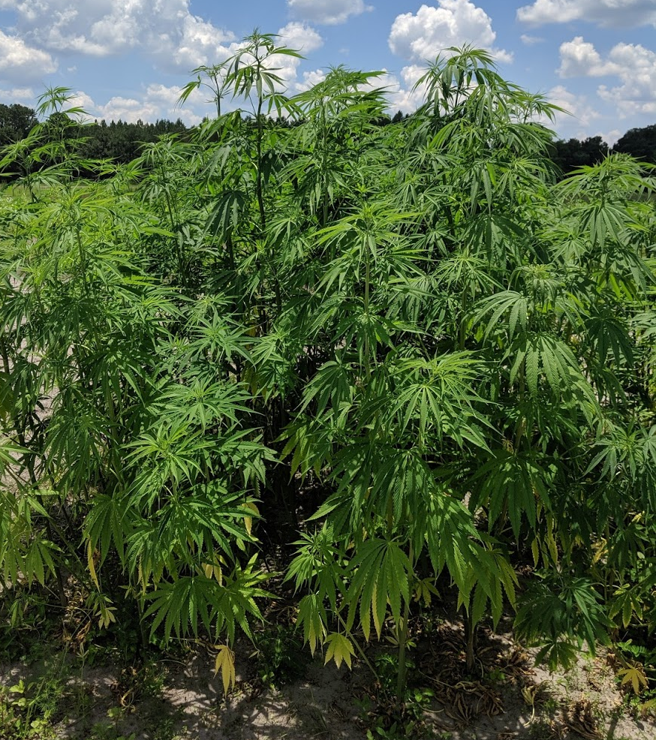
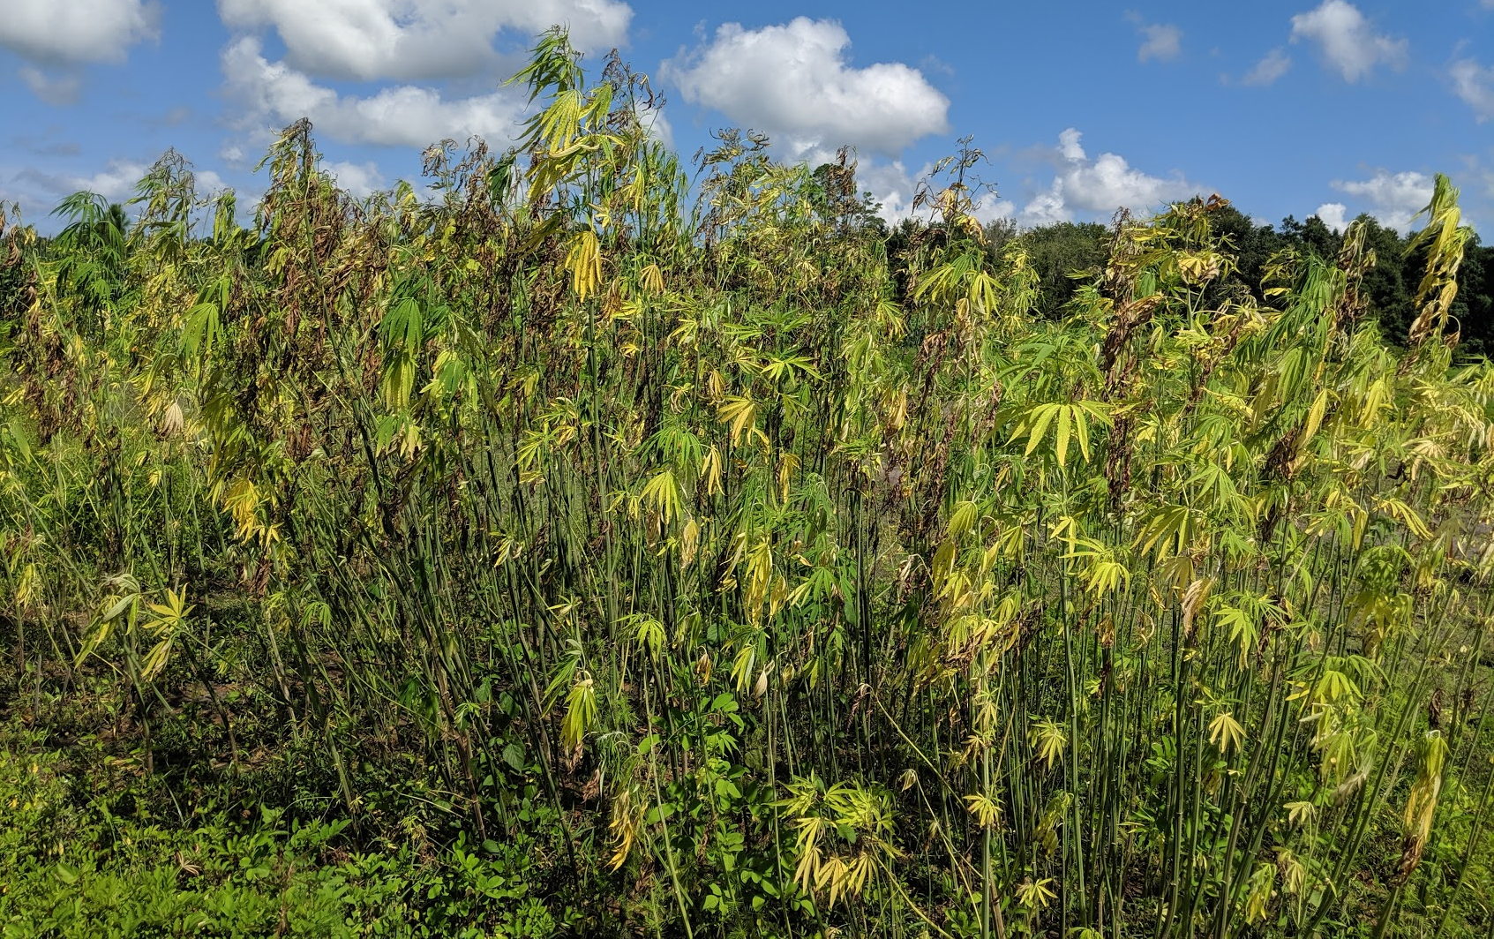

Industrial hemp crop response to waterlogging
Maryjo Valle*¹, Esteban Rios¹, Zachary T. Brym², Kevin Kenworthy¹, John Erickson¹
¹Agronomy Department, University of Florida, Gainesville, FL, USA
²Tropical Research and Education Center, University of Florida, Homestead, FL, USA
*Corresponding Author: maryjovalle@ufl.edu
Rationale
Multi-purpose crop:
  pharmaceutical, food, fiber, etc.
Florida climate: sub-tropical, mild winters and hot, sunny, and muggy summers
Florida soils: ~70% Flatwood soils
  Deep, poorly drained, loamy or sandy soils
  Warm soil temperature
  Aquic soil moisture
Hague, FL Summer 2019
Notes:
Industrial hemp is valued as a multi-purpose crop with profitable potential in Southeastern U.S., thus research has been underway to identify hemp germplasm that will suit the region’s environmental conditions. Florida’s location enhances climactic sensitivity as tropical climates further the rainy season during the summer. Furthermore, most Florida soils are aquods, wet sandy soils with low nutrients, which in tandem with torrential rains can result in devastating economic and crop losses. An industrial hemp plant that shows plasticity to its environment can be economically beneficial to farmers and reduce the likelihood of crop loss. Although waterlogged soils in a 2019 summer hemp variety trial in Hague, FL damaged the crop, there was variation in tolerance to the flooding, particularly from hemp variety Yuma-2, that survived the longest in flooded field conditions.

Slide 2
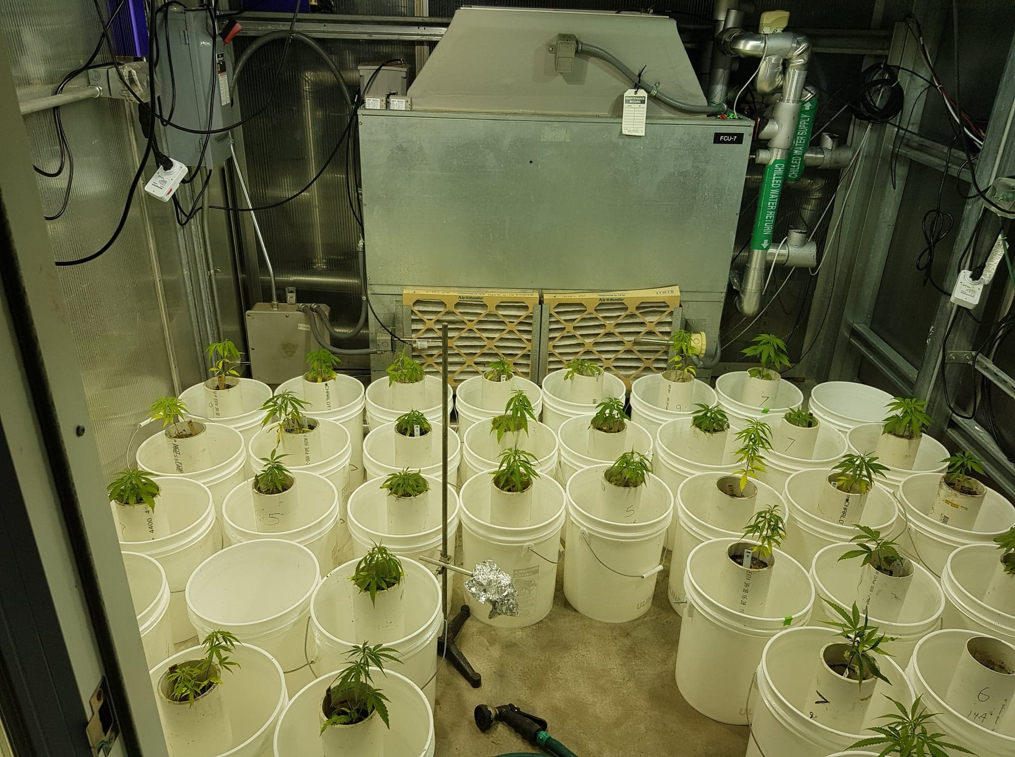
Objective
  Evaluate the effects of flood duration and frequency on industrial hemp variety, Yuma-2
  ~ Determine the maximum potential waterlogging conditions
  ~ Quantify the reduction in yield and photosynthesis
Materials and Methods
  2-factor completely randomized design with four replicates
  Factor 1: Flood Duration ~ 0 h, 24 h, 48 h, 72 h, and 96 h
  Factor 2: Flood Frequency ~ Weekly or Biweekly
  ~2 years
  ~6-week period
Notes:
Following our 2019 field trial, we established a greenhouse study at the UF Agronomy Turf and Forage Physiology lab Gainesville, FL. A manual flooding system pictured below was used to mimic field flood conditions. The experiment was a 2-factor completely randomized design with four replicates: factor 1 being flood duration of which we had 0,24,48,72, and 96 h increments and factor 2 was flood frequency either weekly or biweekly. The experiment took place in 6 week periods in two separate runs.

Slide 3
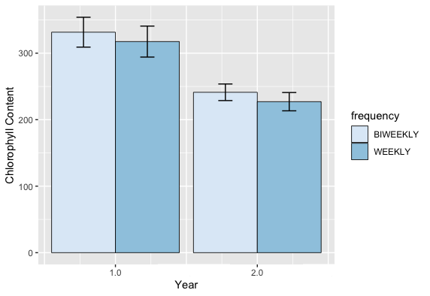
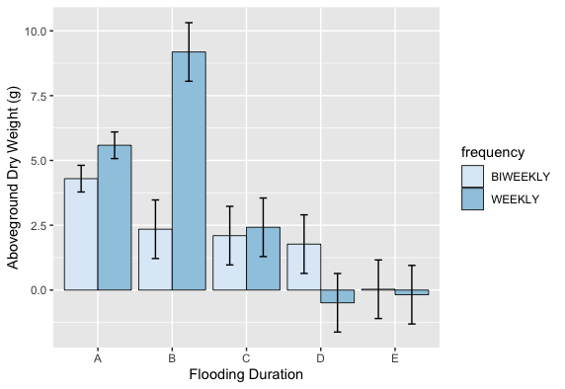
Results
  Chlorophyll Content:
  Aboveground Biomass:
Conclusions
Anoxic soil conditions reduce levels of chlorophyll content (indirect indicator of plant stress).
Drastic turnover in plant health occurred at 48 hours of weekly and biweekly flooding.
Determines the maximum waterlogged conditions that can result in stand loss.
Notes:
From the measured physiological variable, chlorophyll content was lower in year 2 and weekly flooding overall resulted in lower chlorophyll content, which tends to decrease when plants are under stress conditions. Our aboveground biomass greatly decreases as the increment of flooding duration and frequency increased. A major turnover point occurs between 24 to 48 hours of flooding, thereafter plant biomass drops. Key takeaways are that anoxic soil conditions reduce level of chlorophyll content and a drastic turnover in plant yield occurs between 1 to two days of flooding in either weekly or biweekly flood conditions, which we can parallel to frequent rains during the summer in FL. This helps us determine the maximum waterlogged conditions that could result in stand loss for Florida farmers.

